Slide 1
Interconnection

Slide 2
Question!
Think to yourself and write down what ways our world is interconnected and some examples of how we are connected to other places

Slide 3
interconnection
The concept of interconnection emphasises that no object of geographical study can be viewed in isolation. It is about the ways that geographical phenomena are connected to each other through;
environmental processes;
the movement of people;
flows of trade and investment;
the purchase of goods and services;
cultural influences;
the exchange of ideas and information;
political power and international agreements.

Slide 4
Why is our world “shrinking”?

Slide 5
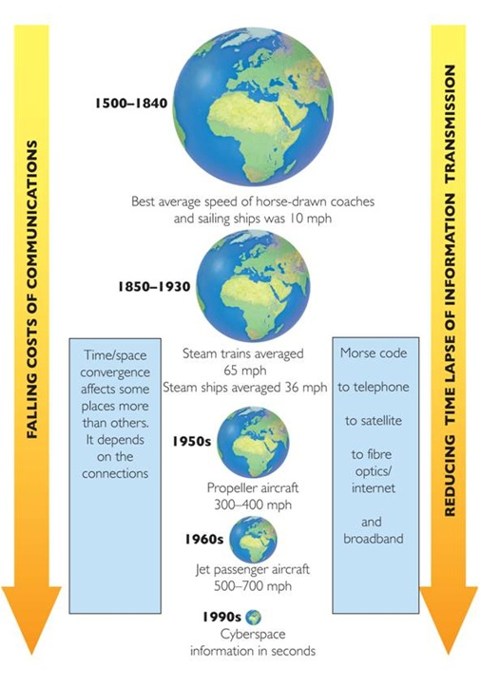

Slide 6
Time-space convergence
This process concerns the changing relationship between time and space, and notably the impacts of transportation improvements on such a relationship. It is closely related to the concept of speed, which indicates how much space can be travelled over a specific amount of time.

Slide 7
Two main factors cause our world to get smaller…
Transportation technology
Communication technology

Slide 8
Question!
Explain the concept of Time-Space Convergence

Slide 9
Communication the internet

Slide 10
Question: What is the internet and why has it grown?
View the video and read the article and answer this question

Slide 11
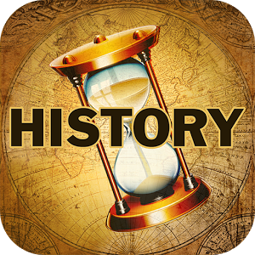
History of the internet

Slide 12


Slide 13
Important!
The internet does not just exist as a 'cloud' concept it is based in physical technology and networks.

Slide 14
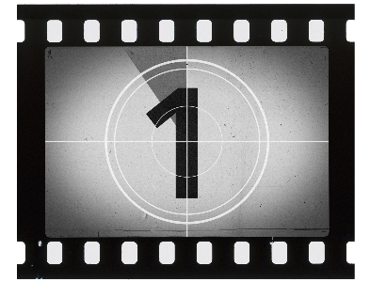
Laying undersea cable

Slide 15
Network of undersea cable

Slide 16
textbook
Page 134 of Pearson Humanities and Social Sciences 9
Read the chapter “Staying Connected via ICT” and answer these questions that follow in your HASS notes. They will be useful for an upcoming assessment.

Slide 17
questions
State what ICT stands for.
Outline what a telegram is. How did it work?
State when the first mobile phone call was made and where.
State where the internet first ‘began life’.
Define the terms ‘Social Media’ and ‘Virtual Communities.’
List the negative effects that social media has on society.
List the impacts of new technologies on the nature of work.
Explain what e-commerce is and the benefits it provides.
Explain why young people in Australia and the United States are Driving Less
Extension: Activities 6 – 9 page 137

Slide 18
Communication mobile phones

Slide 19
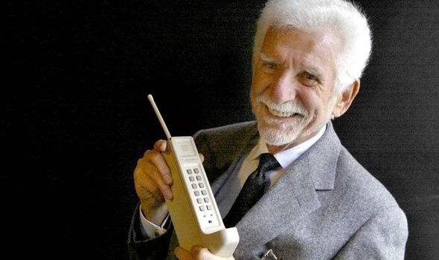
ON April 3, 1973 Martin Cooper made a call on this hefty, hand–held device and made history.

Slide 20
Things have certainly changed a bit since then...

Slide 21
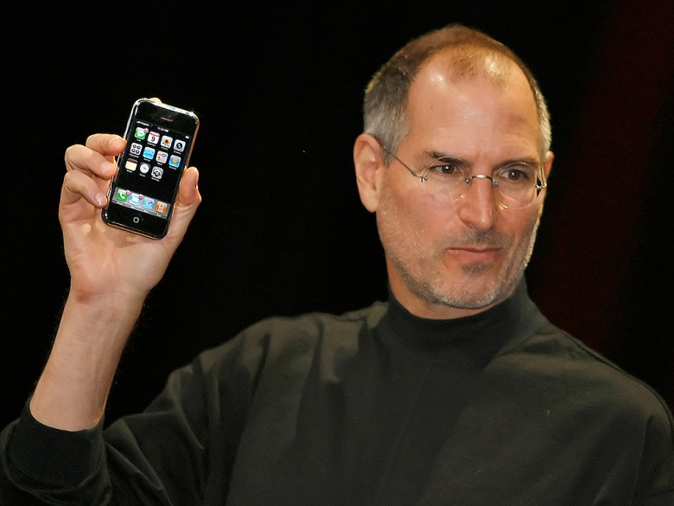

Slide 22
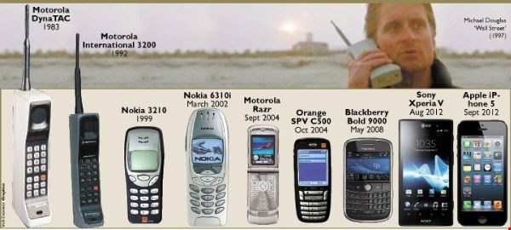

Slide 23
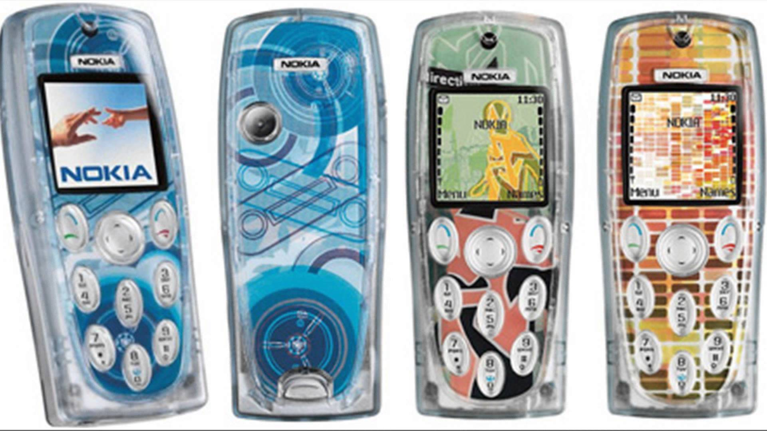

Slide 24

Compare the top mobile phone using countries in the world.
Pay special attention to number of phones per 100 people.

Slide 25
Activity
Watch the following clip and make notes on how mobile phones have changed over the last few years in the form of an RIQ 321
3 x Remember/Recall
2 x Interesting
1 x Question

Slide 27
Activity
Watch the following clip and on your worksheet list 9 uses of mobile phones.

Slide 29
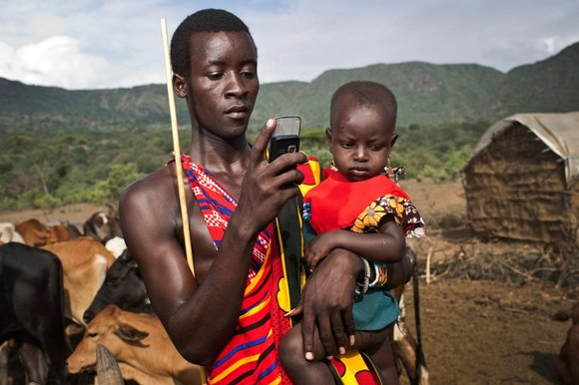
Explain with examples why Mobile Phones are now being referred to as Mobile Devices.
Hint: what capabilities do they now have?

Slide 30
transportation making our world shrink

Slide 31
shipping

Slide 32
SEA TRAVEL - CONTAINERIZATION
View and discuss this BBC article on historical shipping
Write these 3 questions in your HASS books.
What does it show?
What were the constraints on shipping?
What has changed? (see image on right)

Slide 33
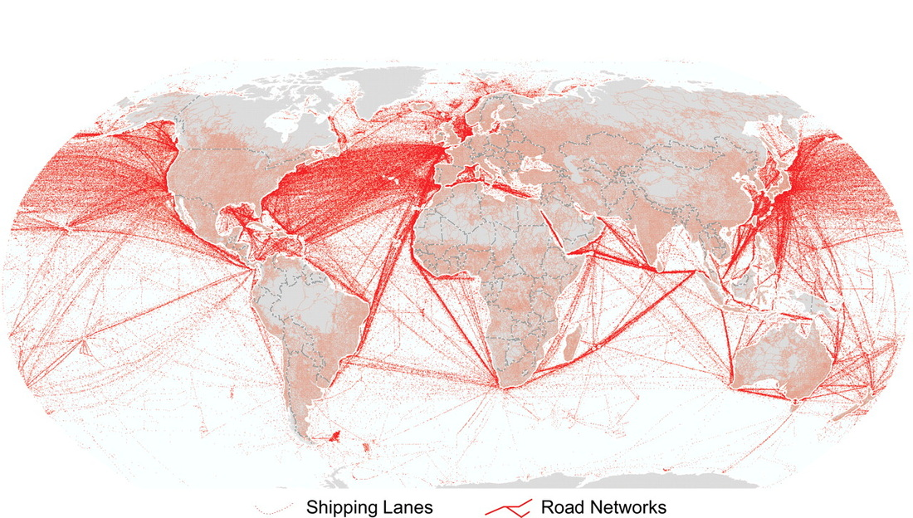

Slide 34
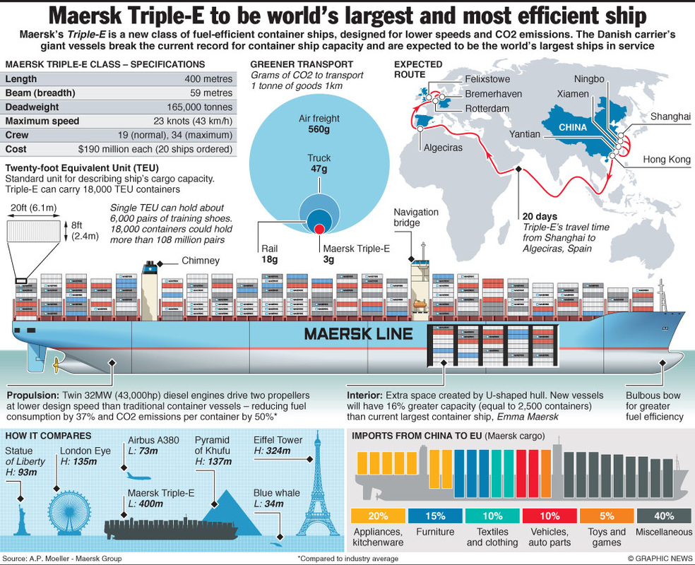

Slide 35
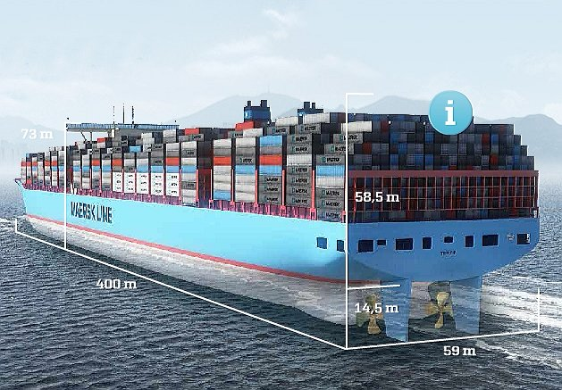

Slide 36
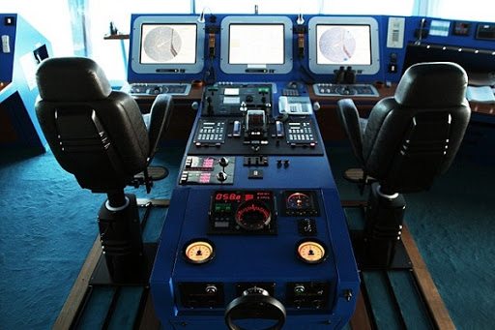

Slide 37
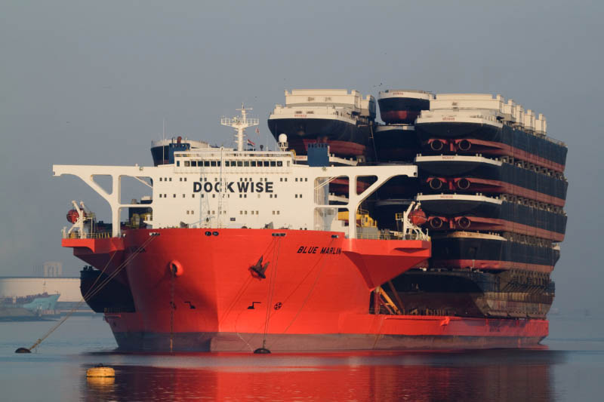

Slide 38
Write down and answer
Containerisation: a shipping method in which a large amount of material (such as merchandise) is packaged into large standardized containers
Questions
List three benefits this innovation has had
How has it contributed to our world shrinking?

Slide 40
Air travel

Slide 41
http://www.abc.net.au/news/2017-09-07/delta-flight-races-hurricane-irma-into-and-out-of-puerto-rico/8881434

